Slide 1
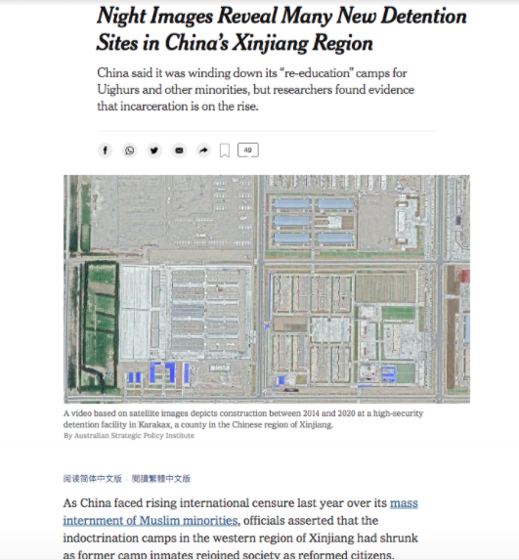
Night Images Reveal Many New Detention Sites in China’s Xinjiang Region
https://www.nytimes.com/2020/09/24/world/asia/china-muslims-xinjiang-detention.html?searchResultPosition=7

Slide 2
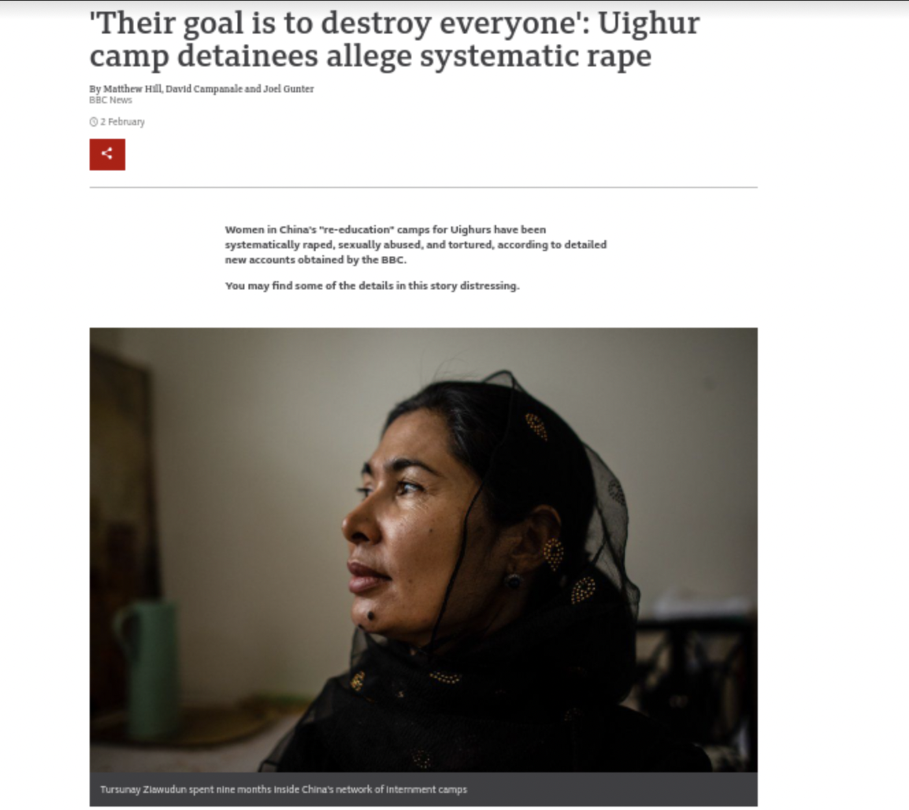
'Their goal is to destroy everyone': Uighur camp detainees allege systematic rape
https://www.bbc.com/news/world-asia-china-55794071

